Slide 1
Contra Project
Sprint 1 Presentation
Ethan Moore: ethan.moore416@topper.wku.edu
Aman Patel: aman.patel689@topper.wku.edu
Will Craddock: Will.Craddock@topper.wku.edu

Slide 2
Project overview and goals
We are creating the Contra game.
Contra is a run and gun game created in 1987.
Theme of this game is humans fighting aliens.
Game has eight stages in the original version, two main characters and about ten different monsters/bosses.
Contra was published on few different platforms after the first success on arcade version.
Our goal is to create a game, maintain the documentation and other research materials we used for creating the game.

Slide 3
Functional requirements
Main character will be controlled by keyboard.
Users will be able to create multiple players and different accounts.
We will implement login systems for users and administrators.
Users will be able to save their progress once they log out and continue once they log back in. And progress will be displayed on the screen.
We will also create a splash screen which displays top scores and login prompt.

Slide 4
Non- Functional Requirements
We will use Unity game engine and development environment to create this game.
We will try to create complete replica of the game but fewer stages.
We will use pre-developed images, audio and some artwork from the original game.
We will be developing source codes for this project.
We will use database to store login information and scores of the players.
We will gather and optimize Performance metrics.
We will gather and optimize Security metrics.
We will gather and optimize User Interface metrics.

Slide 5
Project scope (boundaries)
We will be offering the game in a desktop version.
And our game will consist of three different stages.
But we will try to add as much monsters and bosses we cans so the entertainment level stays the same.

Slide 6
Technical resources (hardware/software)
Hardware architecture details
We are aiming for Contra to run on a typical Desktop or Laptop running a x86 cpu architecture.
Software architecture details
Front-end frameworks/GUI
The front-end will use Unity version 2020.3.17f1 LTS.
Back-end frameworks/OS
The back-end framework we will use for the database is php my admin and my sql
The database will be locally hosted on the users computer

Slide 7
The group’s approach to the project
We have played the game
All of us have experience in some aspect of creating this project.
Aman has experience in database and language and C#
Ethan has experience in Unity and C#.
Will has experience in Unity and database.
Group meets twice every week, and decided to meet outside of scheduled time if necessary.
We expect to spend 9 hours each member per week for this project.
Group meets with client once every week.

Slide 8
Technical feasibility
Unity version 2020.3.17f1 and C# version 8.0 will be used for our project
Php my admin and my sql will be used for the database portion
Our team members are vaguely familiar with unity/scripting

Slide 9
Schedule feasibility
Our project is divided into four different sprints.
Sprint 1: Feasibility, Requirements, Project Scope and Documentation
Sprint 2: Designing and Documentation
Sprint 3: Implementing and Documentation
Sprint 4: Testing and Final Documentation
We estimate to complete this project within 13 weeks of its beginning.

Slide 10
Progress visibility
We will keep a complete documentation.
Meeting with the client every week to discuss our progress.
Weekly progress report.
We will be using gantt chart for showing our progress to our client.

Slide 11
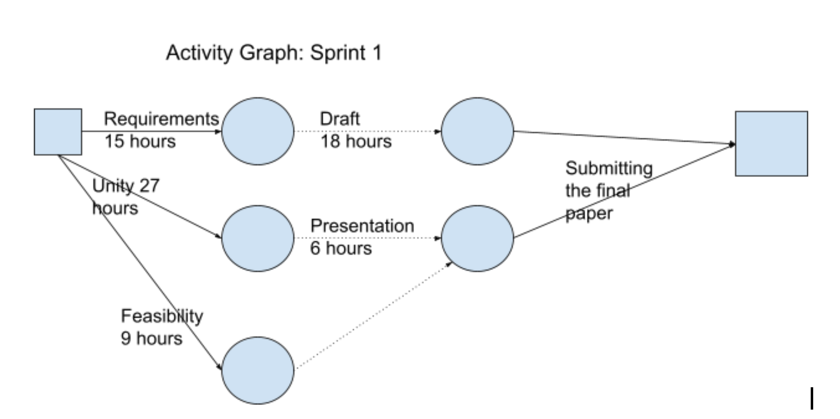
Activity Graph

Slide 12
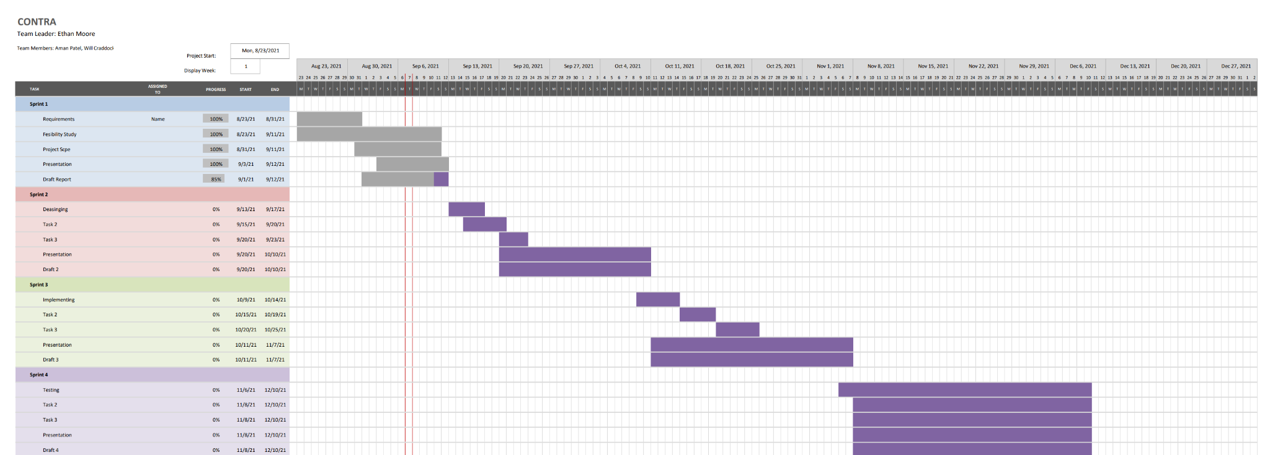
Gantt Chart

Slide 13
Initial risk analysis
Someone decides to drop the class
Getting sick or injured
Prior commitments or responsibilities

